Slide 1

Southend – that’s where we operate
Homeless – that’s our area of concern
Action – that’s what we want to happen
Network – that’s what we do
John Barber – Wednesday 29 January for Test, Learn, Collaborate Event – SHAN presentation

Slide 2
SHAN – How we began
SHAN began in 2008 when a number of us found there were a number of homeless people, typically single folk, who we got to meet that were not getting the help they needed. Often such folk would turn up at the Council and be signposted to non-existent services and because of a lack of resource and money the Council did little more, focusing their efforts on those they had a statutory duty to house. The local homeless hostel run by HARP did provide some help but it was limited and often overnight accommodation was full. Some of the homeless people did not engage with the services that were available and this was not helped given the mental health and addiction issues many were experiencing. At that time the Council were looking to close their own homeless hostels as well as produce a homeless prevention strategy working in partnership with the voluntary and community sector (VCS). SHAN was born out of this paradigm and the words of the acronym: Southend, Homeless, Action and Network describe precisely what we set out to achieve. SHAN has never become formally constituted and the best it has come up with to date and that governs what it does is our terms of reference.

Slide 3
SHAN – Terms of Reference
meet from time to time, but a minimum of four times a year, to discuss homeless issues with a view to finding and implementing solutions and do so in a spirit of partnership.
provide a compassionate network, based on trust and understanding, that will support members in the work they do concerning homeless and other vulnerable persons.
understand the issues around homeless people, including how needs are being met or not being met in Southend, and propose, support and help implement practical and enduring solutions, including the identification and promotion of good practice.
understand government (central and local) policies with respect to homeless people and specifically to engage and partner with Southend Borough Council in the implementation of its Homelessness Prevention Strategy and whenever needs are identified or opportunities arise.
share and disseminate information regarding homelessness and issues affecting those who are homeless, within SHAN and to those who are in contact with SHAN members.
SHAN has no formal membership and has an e-distribution of around 225 persons interested in what we do.
We are non political and non religious but include those from all persuasions amongst our members
We don’t campaign as such and our focus is on what our partners can do in order to make a difference
Our members are mostly involved in homeless related activity, from one of many organisations and none
We recognize many interests and perspectives and for participation we require only relevance and respect.

Slide 4
SHAN – our achievements so far
SHAN has been successful in bringing together a wide range of disparate partners with an interest in homelessness in order to make a positive difference. While it is for others to blow our trumpet, we have done what we set out to do and some of the improvements and facilities seen since we began have been part down to us. One of our main successes comes out of the networking ethos. Bringing together parties that might otherwise not meet has an effect! We have organised two successful conferences, one on immigration and one on homelessness and this has sparked off more action. We meet every other month with full agendas on important topics of concern, with expert speakers and lively discussion. Our meetings are well attended by a wide cross section of those representing statutory, voluntary, community, church groups and individuals. We aim to inform and inspire and make a difference for our homeless friends Those who do attend invariably find sharing information and the networking that goes on to be of immense value. There have been enormous changes when it comes to homeless provision and this to a large extent down to the efforts of our members. The unmet needs are still huge and, while there are many new services operating, street homelessness remains a massive issue.

Slide 5
SHAN – some of our member organisations
Statutory
Southend Council
The Police
NHS providers
Jobcentre Plus
Fire and Rescue
VCS – biggies
HARP
SAVS
Peabody
STARS
Citizens Advice
VCS – newbies
One Love
57 West
Off the Streets
CWNS
CAST

Slide 6
SHAN – A typical agenda
Welcome – thanks – apologies – introductions – ground rules (10 mins)
Minutes of and matters arising from last meeting (10 mins)
Red Cross update (Janine Thomas) (10 mins)
Council update – homelessness (Elsa Moore) (10 mins)
Police Update (Ian Hughes) (10 mins)
CWNS update (John Simmons) / Off the Streets (Del Thomas) (10 mins)
Southend Council – safeguarding matters (Jon Gurrel) (10 mins)
What can we do better in 2020? (Zoey / Marie – One Love) (15 mins)
“Green Pastures” (Helen) (10 mins)
Eviction prevention (Samantha – HARP) (10 mins)
Members updates (All) (Share news of your projects etc.) (10 mins)
AOB & Dates for your diary (5 mins)

Slide 7
SHAN – the need around us 12 years ago
Far fewer services than there are now
Council tended to restrict help to those they had a statutory duty
HARP provided overnight accommodation but were usually full
Significant homeless population – not sure how many
Issue of asylum seeking
Lack of affordable accommodation
Lack of support services e.g. mental health

Slide 8
SHAN – the need around us today
Many more services compared with 12 years ago e.g. emergency shelters and soup kitchens
Council more proactive – helped by the rough sleeper initiative
HARP has many more units for accommodating the homeless
Significant homeless population still – despite more services
Issue of no recourse to public funds for those from overseas
Lack of affordable accommodation
Lack of support services e.g. mental health

Slide 9
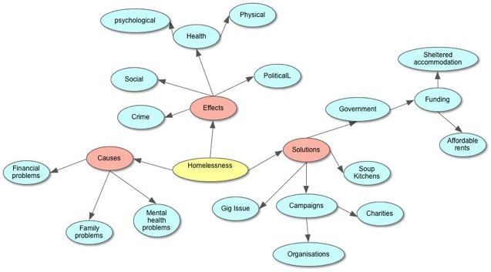
Homelessness – a preliminary stab at producing a mind map

Slide 10
Some questions to ponder
How many homeless people are there in Southend?
How many homeless people are there nationally?
What further measures can be taken locally to prevent homelessness?
Are the present local services fit for purpose?
What are the gaps that still exist?
How can statutory and VCS groups better work together?
How does Southend compare with other local authorities helping the homeless?
What can I do to help?
If you met a homeless person on the streets, how would you likely respond?
If you can run a successful campaign, what would you like it be?

Slide 11
SHAN – some resources
SHAN webpage – contains information about SHAN activities, including agendas and minutes
https://jrbpublications.com/shan/
Southend Rough Sleeper Leaflet – aimed at helping rough sleepers, providing information on where to go for help
https://jrbpublications.files.wordpress.com/2019/05/rough-sleeper-leaflet-v4.pdf
Homeless Reflections – is an ebook updated from time to time that contains many of my thoughts on a wide range of homeless related issues
https://jrbpublications.com/2017/10/12/homeless-reflections/

Slide 12
Finally
Thank you for you attention and your participation today and best wishes in your endeavours to help the homeless.
Remember, homelessness is a complex issue with no simple solutions or totally correct answers. We can all do something, starting with showing kindness to the folk who often through unfortunate circumstances find themselves homeless.
John Barber – SHAN (Chair)
Email: jjandm.barber@blueyonder.co.uk
Tel. 01702-616302
Website: jrbpublications.com

