Slide 1
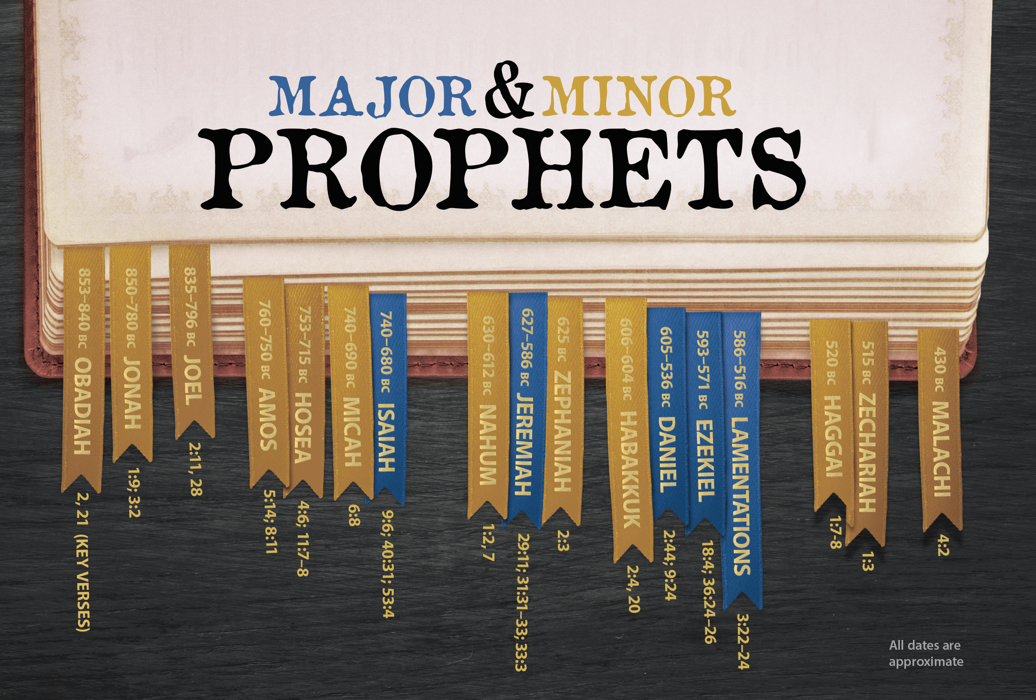
The Prophets of the Bible

Slide 2
Prophets covered so far …
John the Baptist Enoch
Moses Balaam
Deborah Samuel
Nathan Micaiah
The Unknown Prophet Isaiah
Jeremiah Elijah
Elisha

Slide 3
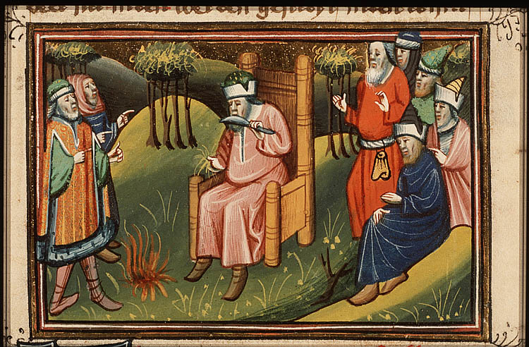
Ezekiel the Prophet (1)

Slide 4
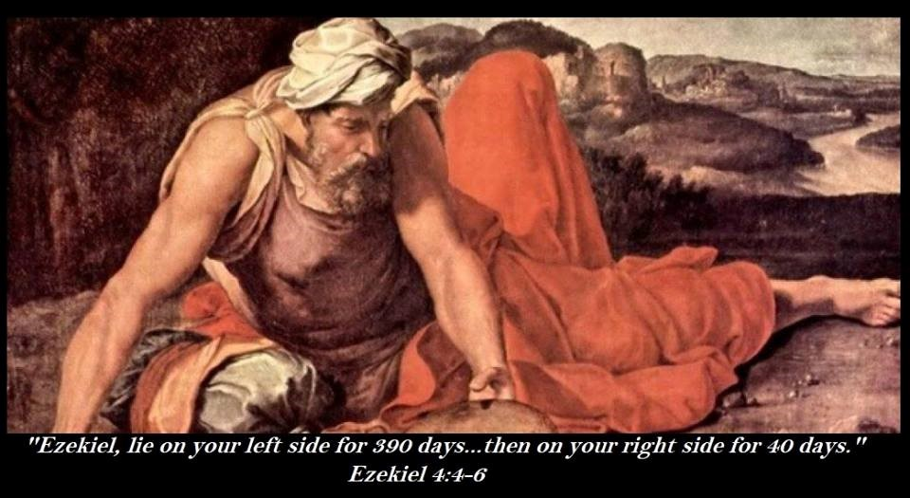
Ezekiel the prophet (2)

Slide 5
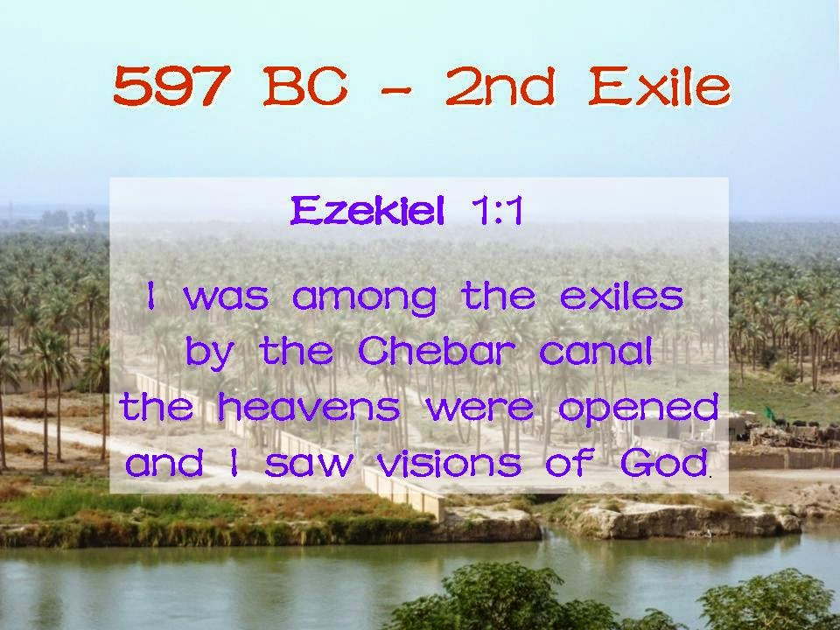
Ezekiel - residency

Slide 6
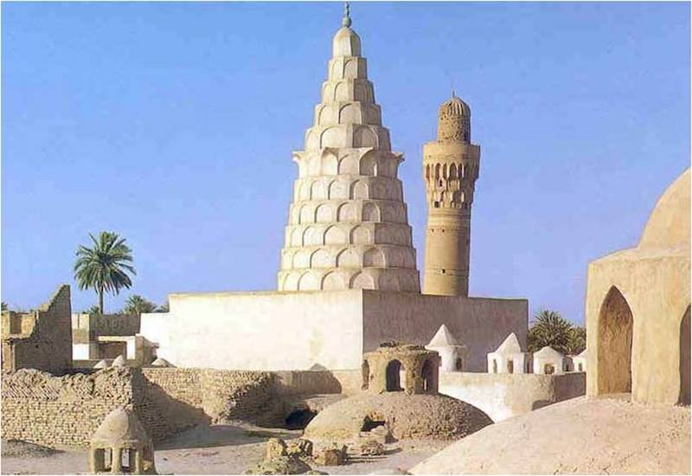
Ezekiel’s tomb

Slide 7
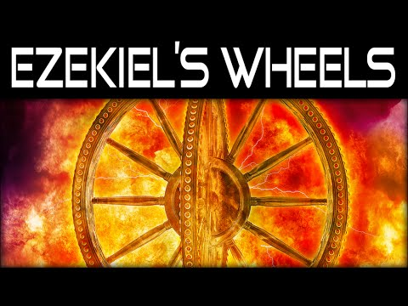

Slide 8


Slide 9
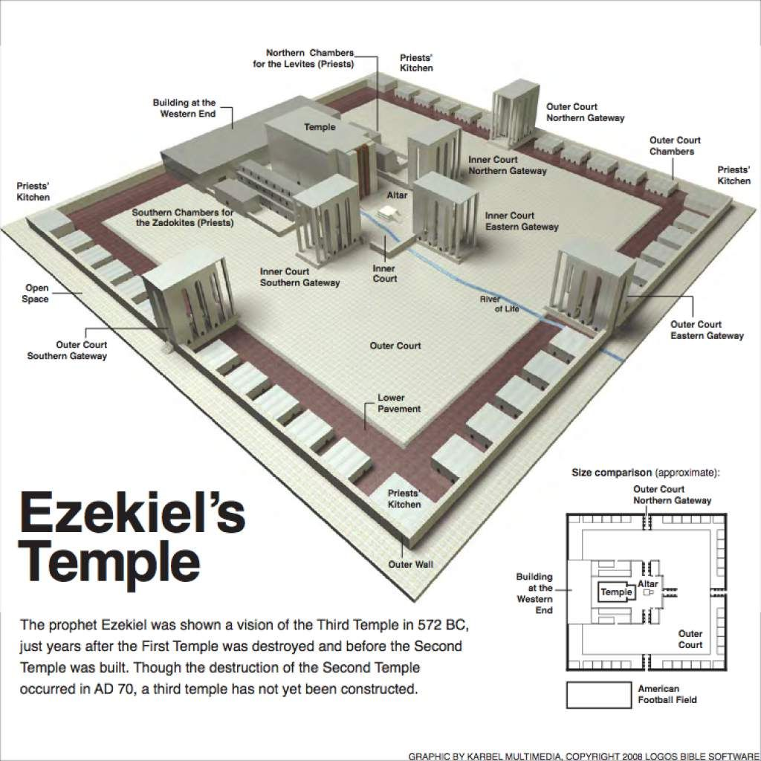
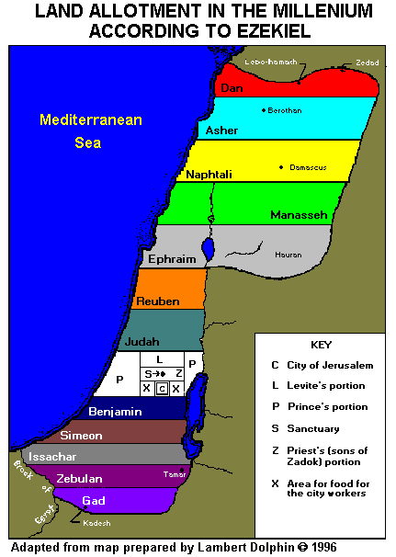
Ezekiel’s Temple

Slide 10
Five weeks in Ezekiel – plan of action
Week 1 – Introduction – considering the context is all important
Week 2 – Calling – chs. 1-3 of Ezekiel plus the prophet’s bio details
Week 3 – Judgment – chs. 4-32 Israel and of the surrounding nations
Week 4 – Hope – chs. 33-39 Restoration following the Fall of Jerusalem
Week 5 – Temple – chs. 40-48 New Temple, New Land, New City

Slide 11
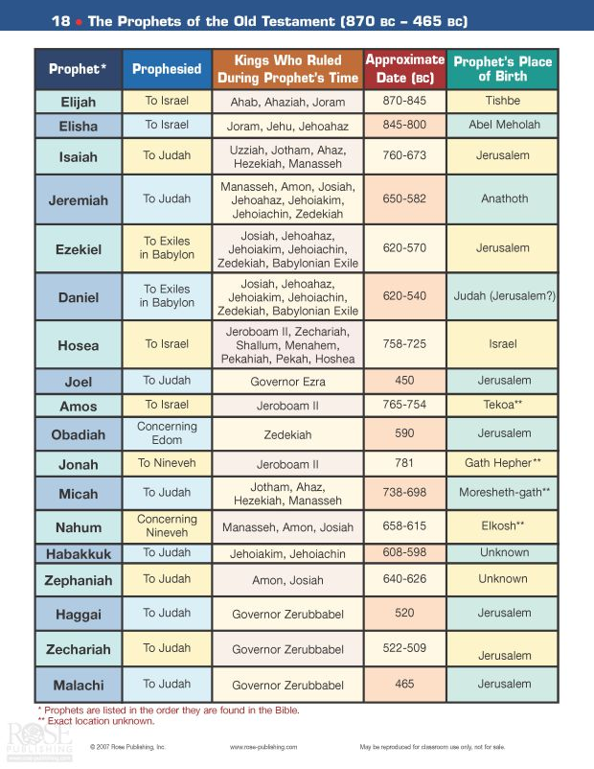

Slide 12
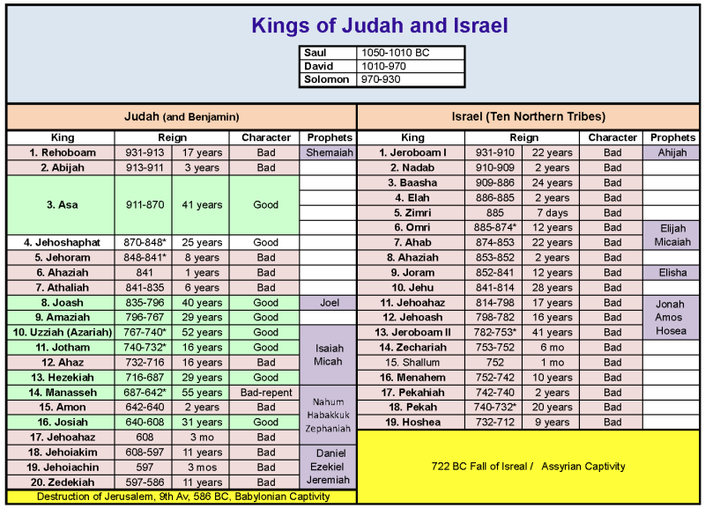

Slide 13
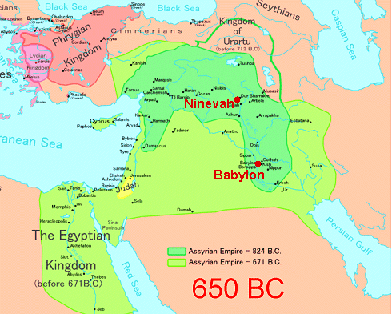

Slide 14
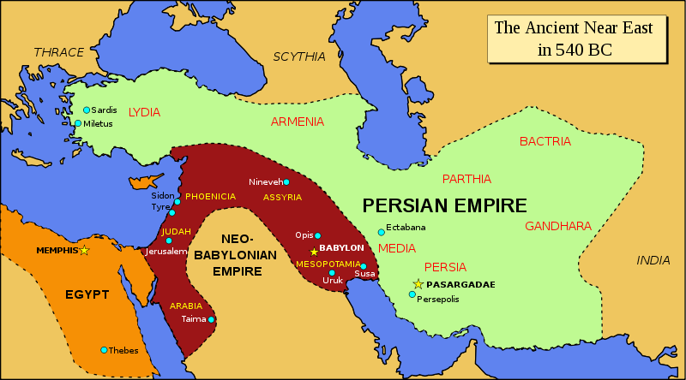

Slide 15
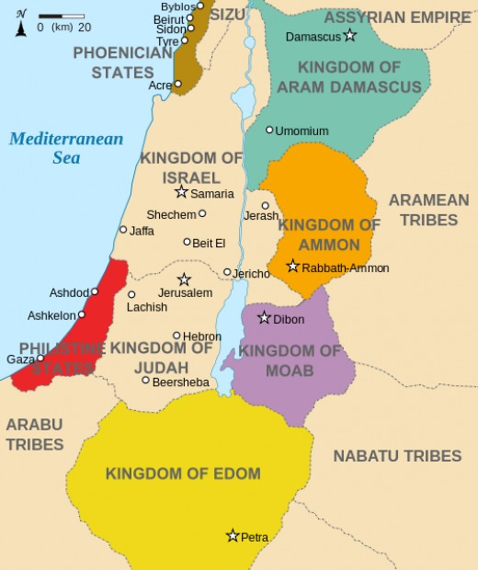

Slide 16
Consider the Context – 2Kings 22-25
Chapter 22 Josiah, Book of the Law, Huldah
Chapter 23 Josiah renews the covenant, Meggido
Jehoahaz, Jehoiakim
Chapter 24 Jehoiachin, Zedekiah
Chapter 25 Jerusalem falls

Slide 17
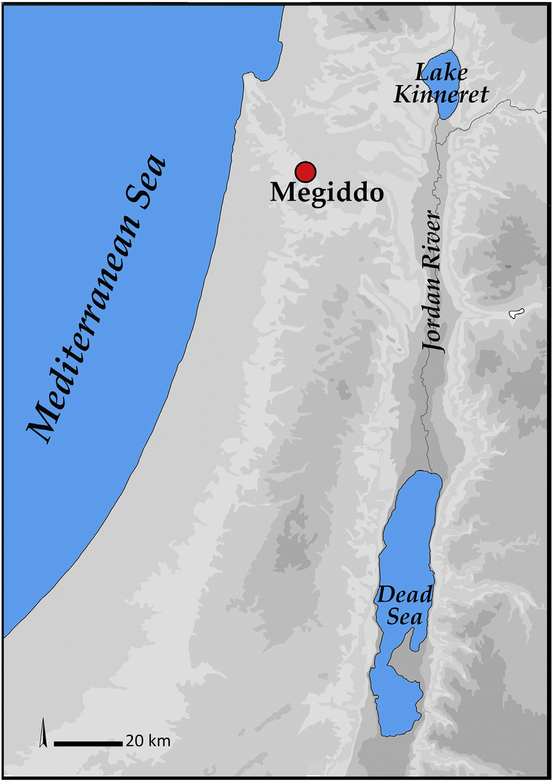
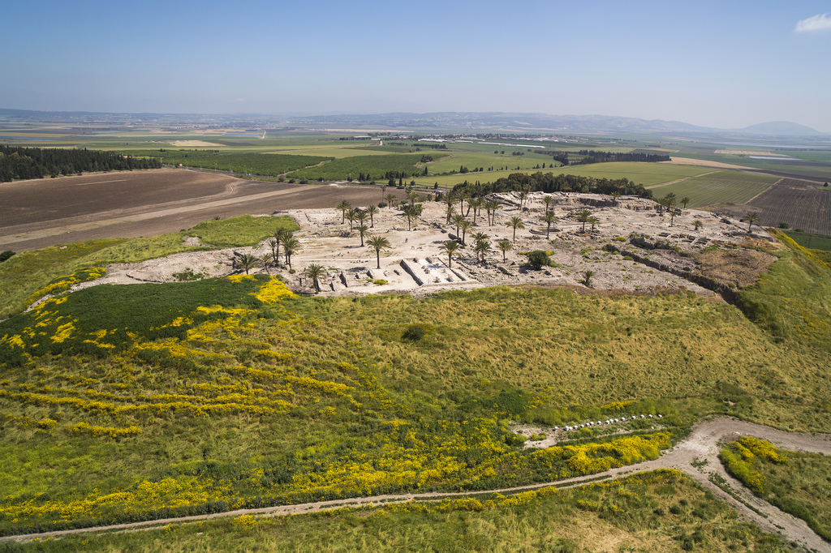
Megiddo

Slide 18
Four ‘Visions’, thirteen ‘Pictures’ and eight ‘Words’
1). A Vision of The Glory of the Lord - and Ezekiel’s Call Chapter 1.1 - 3.15
2). A Word About the People Chapter 3.16-27
3). An Acted Parable of Siege Chapters 4 - 5
4). A Word About Idolatry Chapters 6 - 7
5). A Vision of Idolatry in the Temple - and the Lord’s Departure Chapters 8 - 11
6). An Acted Parable of Exile Chapter 12
7). A Word to the ‘Prophets’ Chapters 13 - 14
8). The Illustration of The Useless Vine Chapter 15
9). The Allegory of The Adulterous Wife Chapter 16
10). The Parable of The Eagles and The Vine Chapter 17
11). A Word to the People Chapter 18
12). A Lament for The Lion Cubs and The Vine Chapter 19
13). A Word to the Nation Chapters 20 - 22
14). The Allegory of The Two Sisters Chapter 23
15). The Parable of The Cooking Pot Chapter 24.1-14
16). The Allegory of Ezekiel and His Wife Chapter 24.15-27
17). Words and Laments for the Nations Chapters 25 - 32
18). The Allegory of Ezekiel The Watchman Chapter 33
19). A Word to the ‘Shepherds’ Chapter 34.1-10
20). The Allegory of God The Good Shepherd Chapter 34.11-31
21). The Allegory of The Land Chapters 35 - 36
22). A Vision of A Valley of Bones - and Resurrection Chapter 37.1-14
23). The Acted Parable of The Sticks Chapter 37.15-27
24). Seven Words Against Gog Chapters 38 - 39
25). A Vision of a New Temple, a New Land, and a New City Chapters 40 - 48

Slide 19
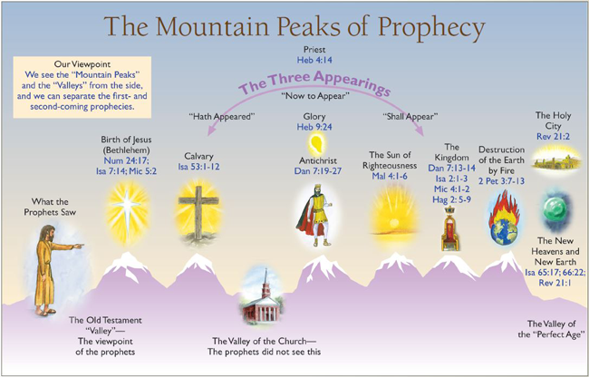

Slide 20
Gog and Magog
“God’s Message came to me: “Son of man, confront Gog from the country of Magog, head of Meshech and Tubal. Prophesy against him. Say, ‘God, the Master, says: Be warned, Gog. I am against you, head of Meshech and Tubal. I’m going to turn you around, put hooks in your jaws, and drag you off with your whole army, your horses and riders in full armor—all those shields and bucklers and swords—fighting men armed to the teeth! Persia and Cush and Put will be in the ranks, also well-armed, as will Gomer and its army and Beth-togarmah out of the north with its army. Many nations will be with you!” Ezekiel 38:1-6
“When the thousand years are up, Satan will be let loose from his cell, and will launch again his old work of deceiving the nations, searching out victims in every nook and cranny of earth, even Gog and Magog! He’ll talk them into going to war and will gather a huge army, millions strong. They’ll stream across the earth, surround and lay siege to the camp of God’s holy people, the Beloved City. They’ll no sooner get there than fire will pour out of Heaven and burn them up. The Devil who deceived them will be hurled into Lake Fire and Brimstone, joining the Beast and False Prophet, the three in torment around the clock for ages without end”. Revelation 20:7-10

Slide 21
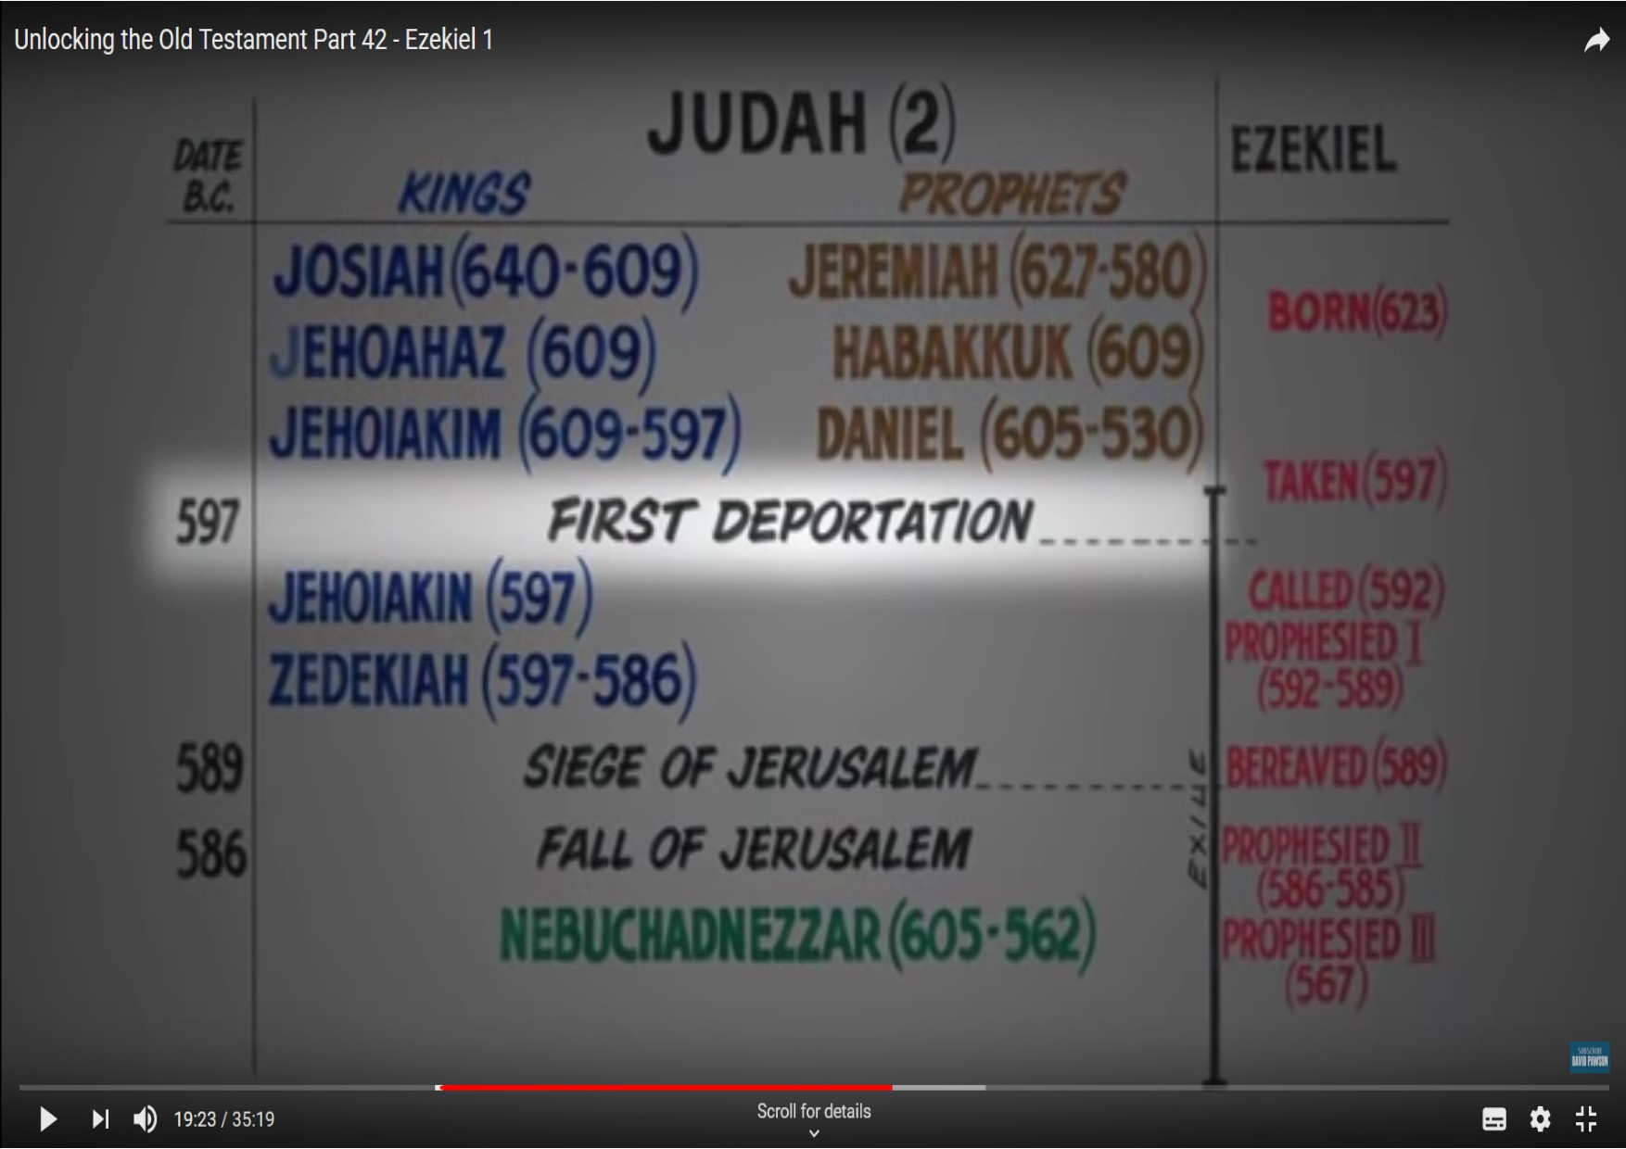

Slide 22
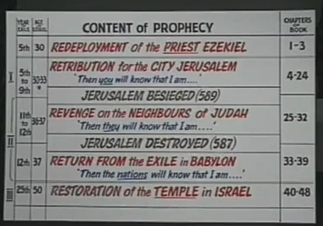

Slide 23
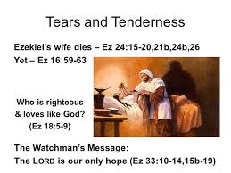

Slide 24
