Slide 1
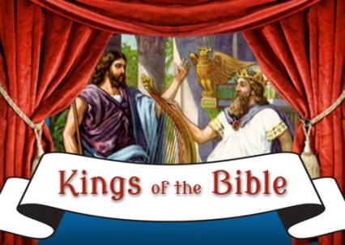
The Kings of the Bible
Providence Baptist Church Bible Study – 28/11/18

Slide 2
What we have covered
Week
Overview and context
Saul
David
Solomon
Rehoboam and Jeroboam
Kings of Israel and Judah
Hezekiah (Jehoshaphat and Josiah)
Kings of Persia
Melchizedek
Summary and lessons

Slide 3
Principles
King (rulers of nations and empires (and cities)) play an important part in the Bible. Prosperity of a nation often depends on who is in power (Proverbs 29:2,4),
Regarding kings in our own time, often we look on them more with consternation.
Israel is at the centre of our study and so is God
The need to apply 2Timothy 3:16, 17 to our study
We are called to respect kings, submit to and obey rulers, them who God ordains (good and bad). Ref. examples of Jesus, Peter, Paul – 1Peter 2:13,14, Romans 13:1,2; need to pray for kings 1Timothy 2:1-2

Slide 4
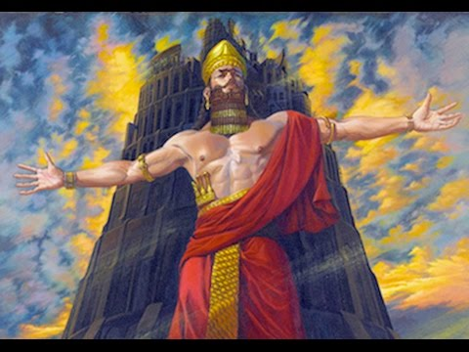
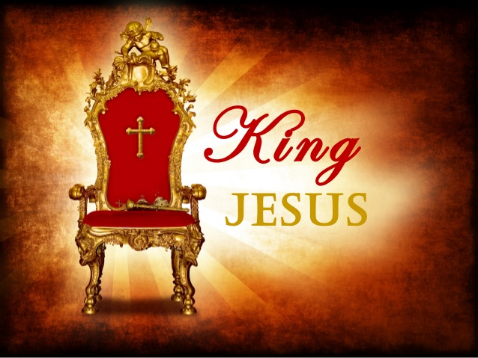
From Nimrod to Jesus

Slide 5
Kings with respect to Israel
From Adam to Noah - none
From Noah to Abraham - Nimrod
From Abraham to Moses and Joshua - Pharoah
Under the Judges – all the surrounding nations had kings except for Israel
The united kingdom of Israel (twelve tribes)
The divided kingdom of Israel and Judah
Exile and post exile – kings of Babylon, Persia
Inter testament – kings Greece
New testament – Caesar, Jesus
Until Jesus, who is the King of kings, returns

Slide 6
It was not God’s intention for Israel to have a king but
Deuteronomy 17:14-20 … if they were to have a king … these are the qualifications that are needed …
Not a foreigner
Not a war monger
Not dependant on Egypt
Not many wives
Studies the law
Not proud and arrogant

Slide 7
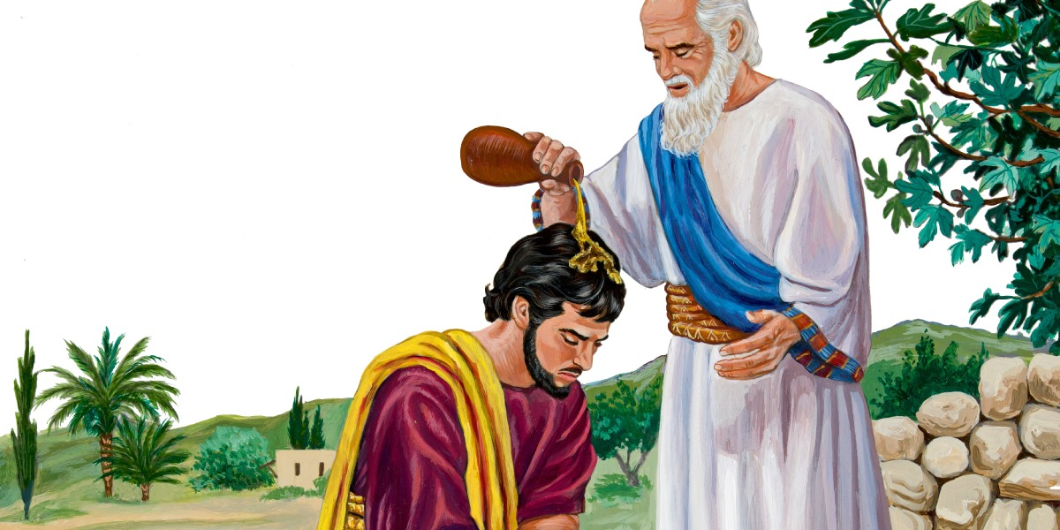
Saul
“In those days Israel had no king; everyone did as they saw fit.” Judges 21:25
“Nevertheless the people refused to obey the voice of Samuel; and they said, Nay; but we will have a king over us; That we also may be like all the nations; and that our king may judge us, and go out before us, and fight our battles.” 1Samuel 8:19,20
King Saul – a man that looked the part and who started his reign with so much promise, with God blessing him and wanting to establish his reign, but Saul disobeyed God and God rejected him.

Slide 8
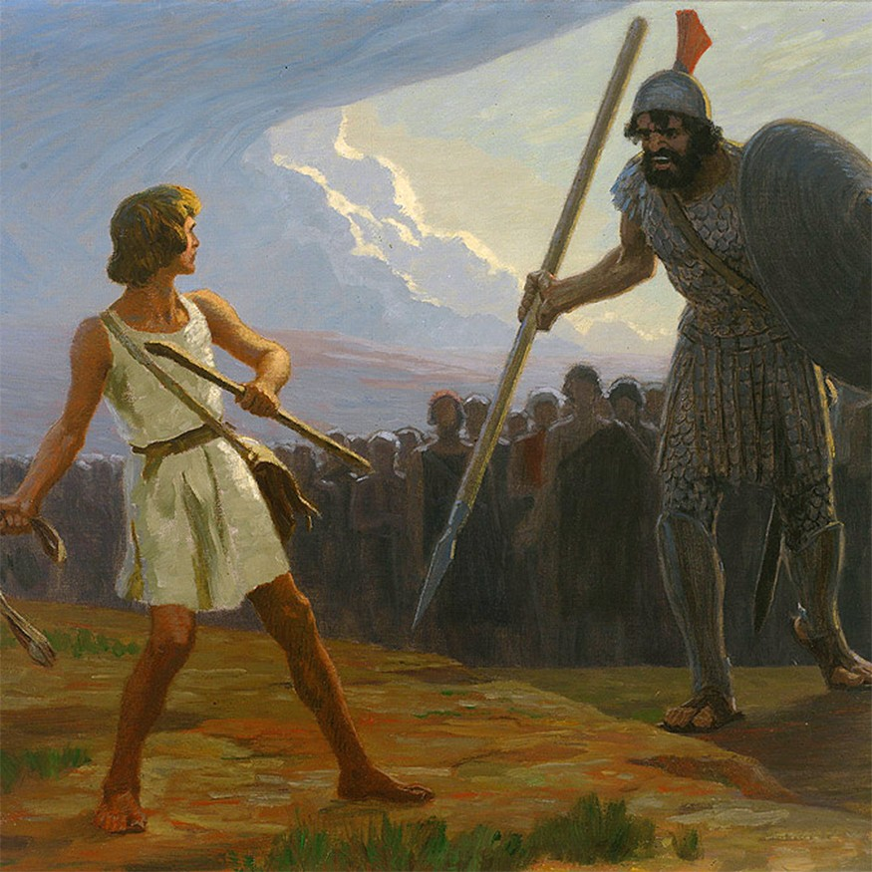
David
Man looks on the outward appearance but God looks at the heart
Acts 13:21-23 – he was a man after God’s own heart
And this despite many struggles, faults and sins, especially regarding Bathsheba and Uriah
Kingdom was established under David

Slide 9
David – cont
Humble – Lowborn men are but a breath, the highborn are but a lie; if weighed on a balance, they are nothing; together they are only a breath. Psalm 62:9
Reverent – I call to the Lord, who is worthy of praise, and I am saved from my enemies. Psalm 18:3
Respectful – Be merciful to me, O Lord, for I am in distress; my eyes grow weak with sorrow, my soul and my body with grief. Psalm 31:9
Trusting – The LORD is my light and my salvation– whom shall I fear? The LORD is the stronghold of my life– of whom shall I be afraid? Psalm 27:1
Loving – I love you, O Lord, my strength. Psalm 18:1
Devoted – You have filled my heart with greater joy than when their grain and new wine abound. Psalm 4:7
Recognition – I will praise you, O Lord, with all my heart; I will tell of all your wonders. Psalm 9:1
Faithful – Surely goodness and love will follow me all the days of my life, and I will dwell in the house of the LORD forever. Psalm 23:6
Obedient – Give me understanding, and I will keep your law and obey it with all my heart. Psalm 119:34
Repentant – For the sake of your name, O Lord, forgive my iniquity, though it is great. Psalm 25:11

Slide 10
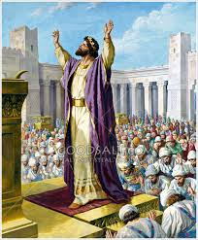
Solomon
Kingdom was at its height due to David establishing it
Started off by having to do a clean up operation
He began as dedicated to God and to serving the people
Building and dedicating the Temple was perhaps his highlight
Was given the wisdom he asked for but also riches and honor
Fell away in later years
Thereby sowing the seeds for division and decline

Slide 11
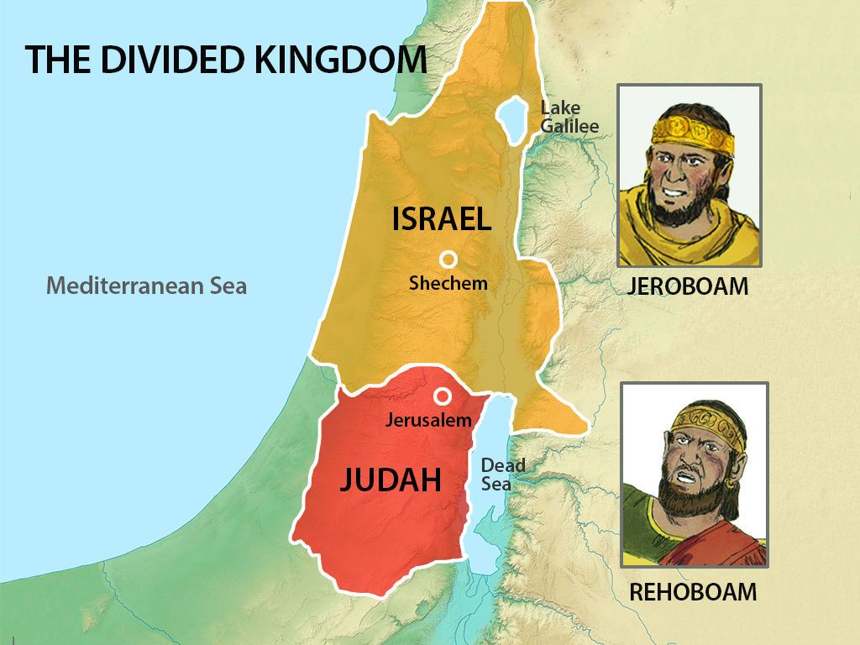
Jeroboam and Rehoboam

Slide 12
Jeroboam and Rehoboam – cont
Jeroboam
The rebel king
Anointed by God
Golden calves (Bethel, Dan)
Rehoboam
Foolishness
People turned further away from God
Decline and subjugation

Slide 13
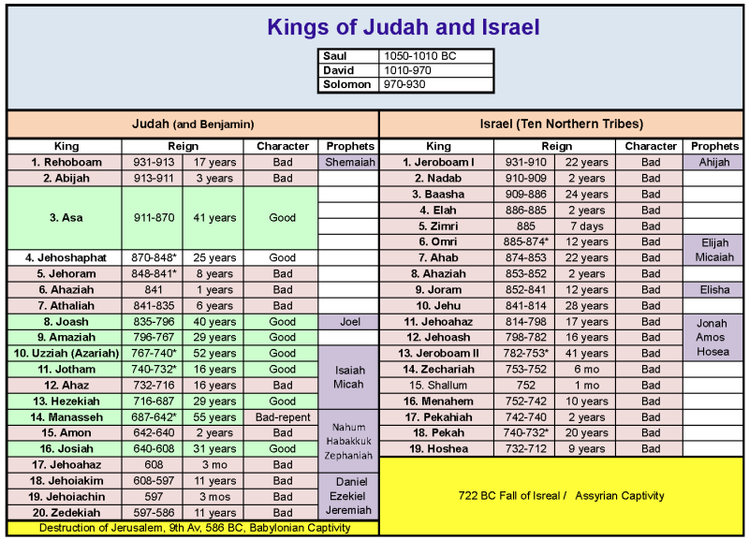

Slide 14
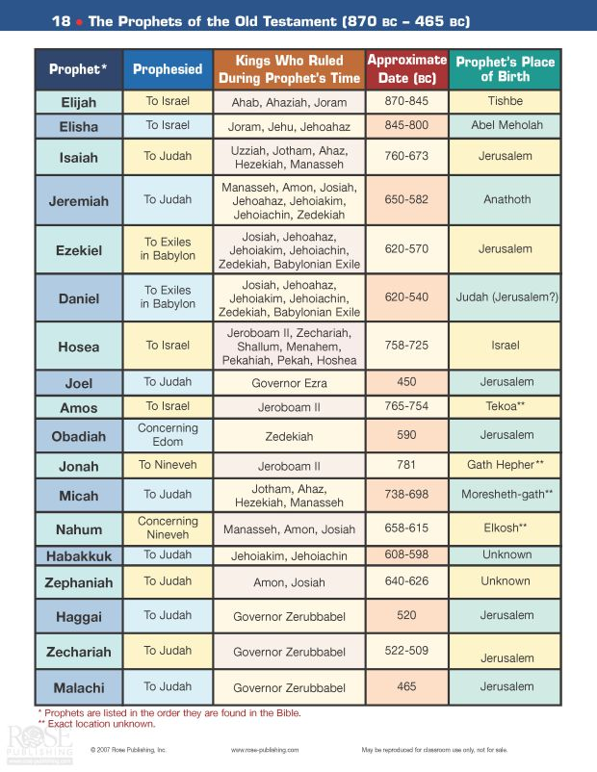

Slide 15
Good, bad and in-between
Bad kings did good things; good kings did bad things
“Good” invariably linked to dedication to God
“Bad” invariably linked to practising idolatry
Some good kings still allowed the High places
Bad kings who became good
Good kings who became bad
Time only allows to skim the surface on some of the kings of Judah and Israel. I have selected seven which between them illustrate all of these tendencies.

Slide 16
Asa
2Kings 9 1-24, 2Chronicles 14:1 – 16:14
Asa was a good king – he got rid of false religion and governed well. He trusted God when attacked. He fell away in later life and did not turn to God in his troubles.

Slide 17
Jehu
2Kings 9:1 – 10:35
Like all the kings of Israel he was a bad king, and yet he was anointed by God for the task and did good by doing what God told him by getting rid of some of the false religion.

Slide 18
Jehoram
2Chronicles 21
Jehoram was a thoroughly bad king of Judah, entirely ruthless in getting rid of any opposition. He had a horrible end and the tragedy is when he died NO-ONE mourned his death.

Slide 19
Manassah
2Kings 21:1-18, 2Chronicles 33:1 – 33-20
Manassah was an evil king (he even sacrificed his own children). He was judged severely but in the end he returned to God and God was merciful.

Slide 20
Jehoshaphat
2Kings 22: 41-50, 2Chronicles 17:1 – 21:1
This is the guy that went to war and at the head of the army was a choir of God worshippers. Because of his dedication to God and the bringing in of proper worship of God, the fear of God came upon the surrounding nations.

Slide 21
Hezekiah
2Kings 18:1 – 20:21, 2Chronicles 29:1 -32:33
Another godly king who brought back pure worship. When confronted with the Assyrian army and he have over the letter telling him to capitulate over to God and he prayed for deliverance, and God delivered. Sadly, in later years God told him to put his house on order.

Slide 22
Josiah
2Kings 22:1 – 23:30, 2Chronicles 34:1 – 35:27
“Josiah removed all the detestable idols from all the territory belonging to the Israelites, and he had all who were present in Israel serve the Lord their God. As long as he lived, they did not fail to follow the Lord, the God of their ancestors.”

Slide 23
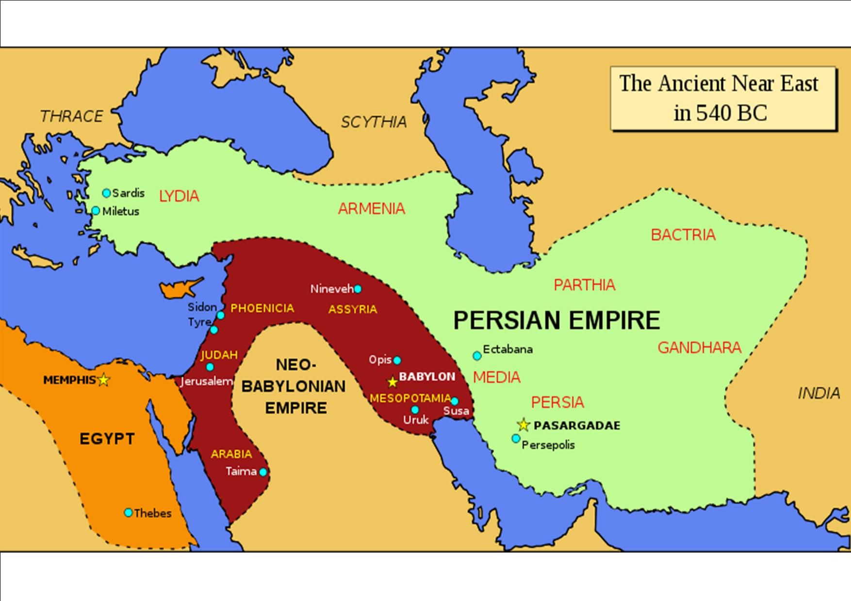

Slide 24
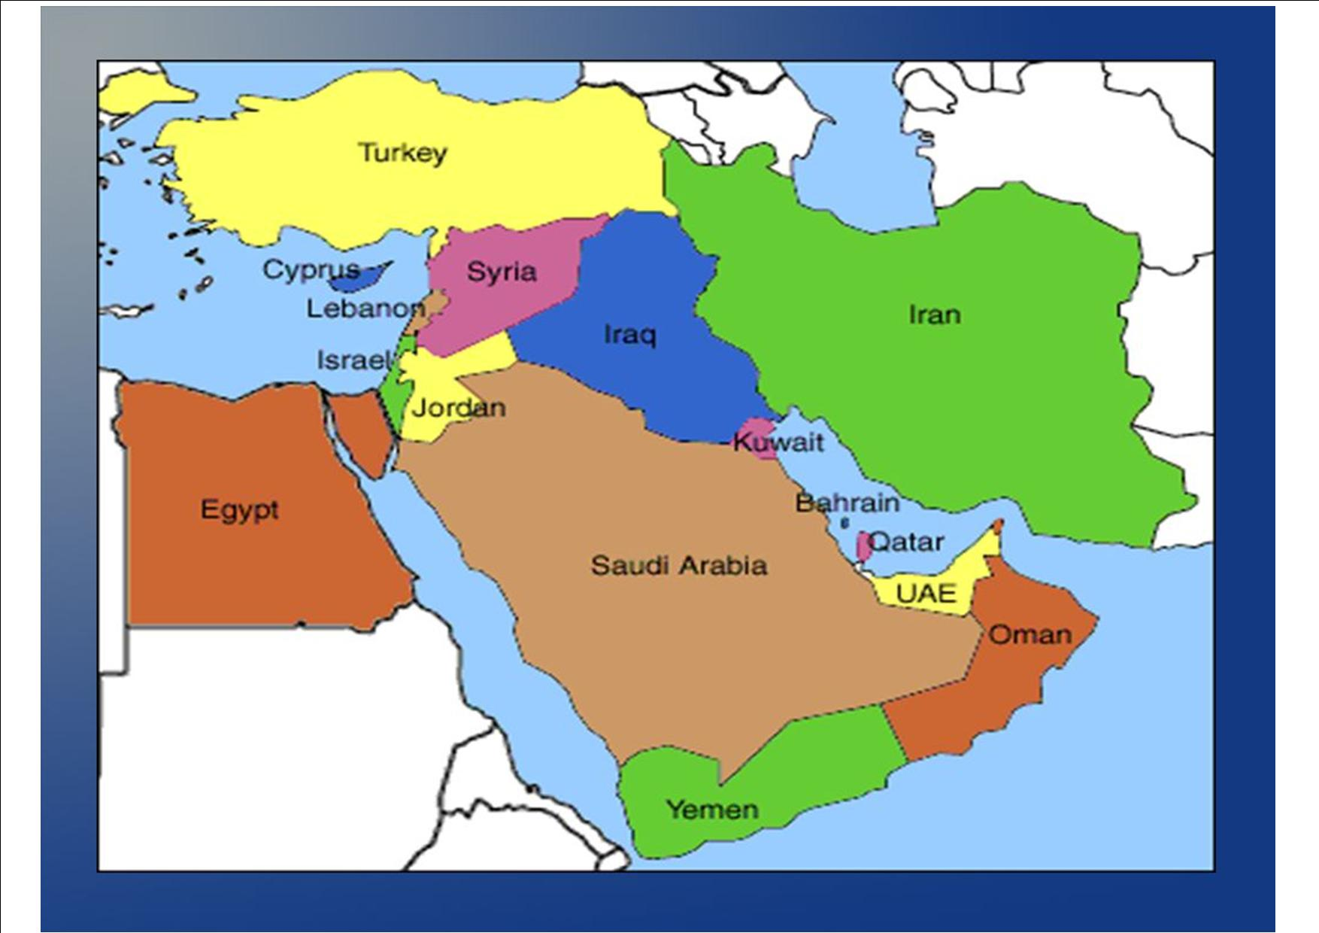

Slide 25
First came the Babylonians
Consider Daniel – bridges two great empires (Babylon and Persia)
Ch 1 Nebuchadnezzar and Daniel (exiled under Jehoiakim)
Ch2 Nebuchadnezzar’s dream – Babylon, Persia, Greece and Rome
Ch3 Image of gold and the fiery furnace for Daniels’ three friends
Ch4 Nebuchadnezzar’s dream of a tree – which was his humiliation and restoration – which all came to pass
Ch5 Belshazar and the writing on the wall (then Darius the Mede)

Slide 26
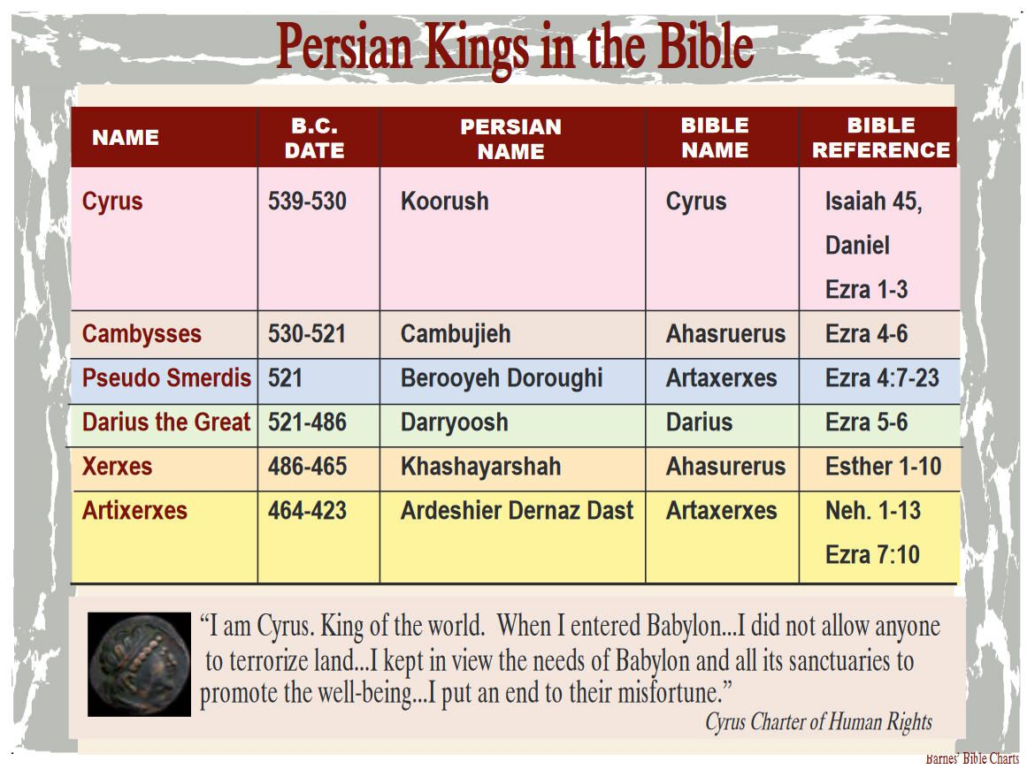

Slide 27
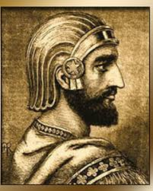
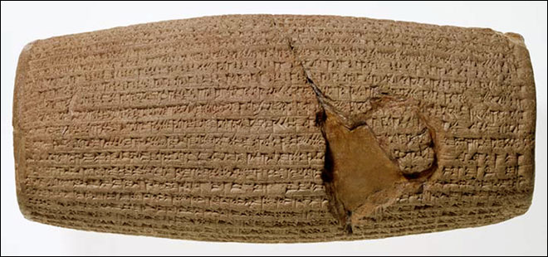
Cyrus the Great
Isaiah 44:24-28; about God, about Cyrus (significance – 200 years before it happened).
Isaiah 45:1-13; more about Cyrus, the Lord’s anointed and how God deals with him / Israel
Ezra 1:1-6; showed how was the prophecy revealed – despite the various hold ups?
The Cyrus cylinder was propaganda praising his achievements. But he was an enlightened king in every way: culture, engineering, government etc.

Slide 28
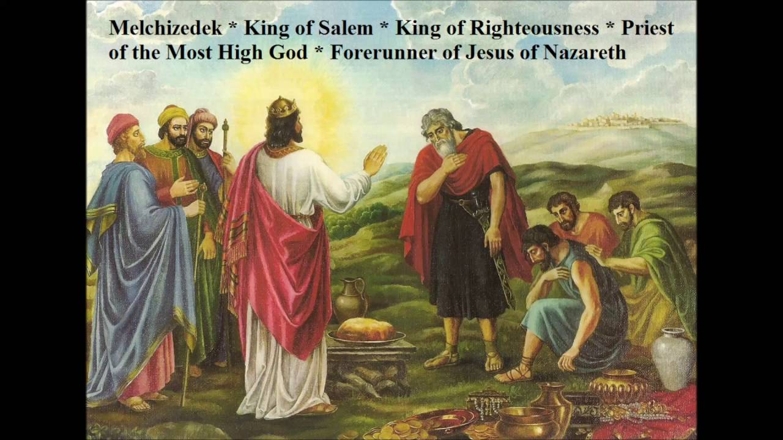
Melchizedek

Slide 29
Melchizedek – cont
Melchizedek was priest of the Most High God and king of Salem (Jerusalem). He met Abraham after the war fought between the four kings against the five and blessed him. Following the blessing Abraham gave him a tenth of all he had (Genesis 14)
“The Lord hath sworn, and will not repent, Thou art a priest for ever after the order of Melchizedek” – Psalm 110:4
“But this man, because he continueth ever, hath an unchangeable priesthood. Wherefore he is able also to save them to the uttermost that come unto God by him, seeing he ever liveth to make intercession for them. For such an high priest became us, who is holy, harmless, undefiled, separate from sinners, and made higher than the heavens” – Hebrews 7:24-26

Slide 30
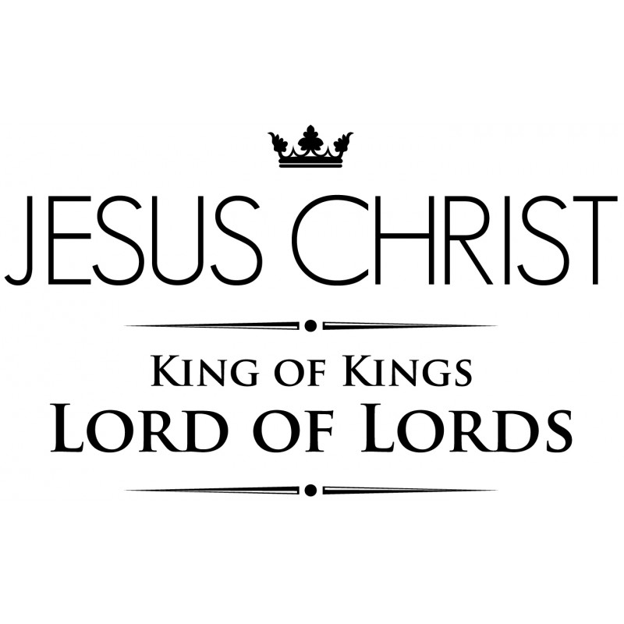

Slide 31
What have you learned?
?

Slide 32
What I have learned and do ponder
God anoints kings and uses all sorts of people
Bad kings can become good and good kings bad
God sees us as we are, yet his inclination is to show mercy
Kings affect those they rules over and vice versa
God has a special love for his chosen people (Israel)
God sends his prophets to warn, encourage etc.
The lure of idolatry is ever present and is with us today
The application now is in the way God deals with nations
God’s word always comes to pass, even after many years
The importance of trusting in God and is the key for blessing
God is holy and He is to be honoured and obeyed
Always something new – compare scripture with scripture

