Slide 1
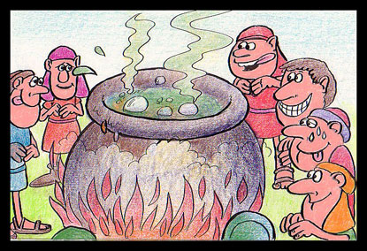
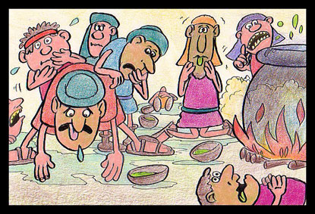
Death in the Pot
2Kings 4 38-41

Slide 2
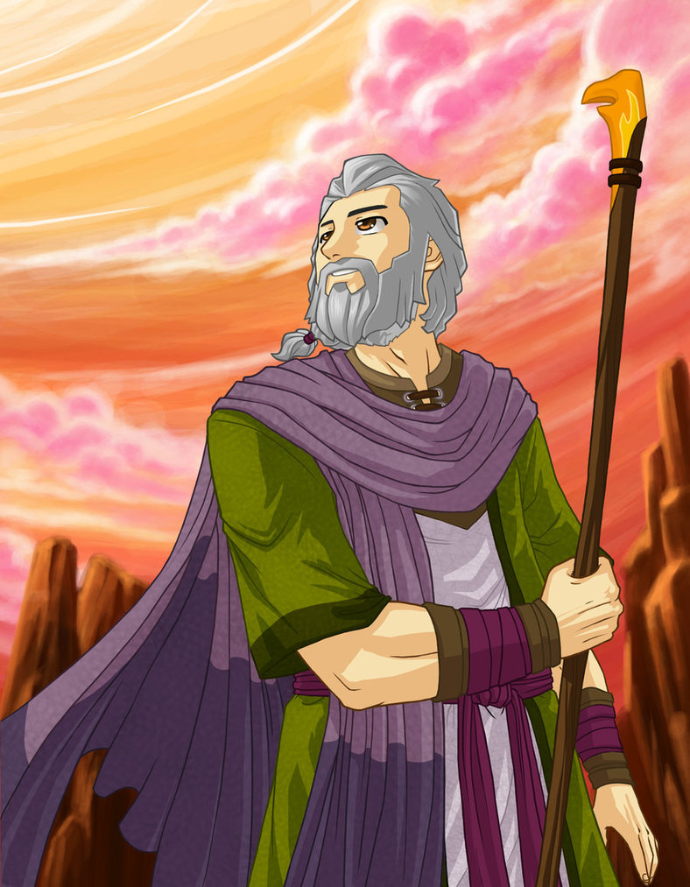
The Life and Times of Elijah the Prophet
Reference:
Sermons 1,2 and 3
1Kings 17 – 2Kings 2

Slide 3
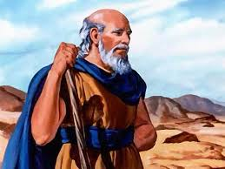
The Life and Times of Elisha the Prophet
Reference:
Bible studies 1 - 5
1Kings 19 – 2Kings 13

Slide 4
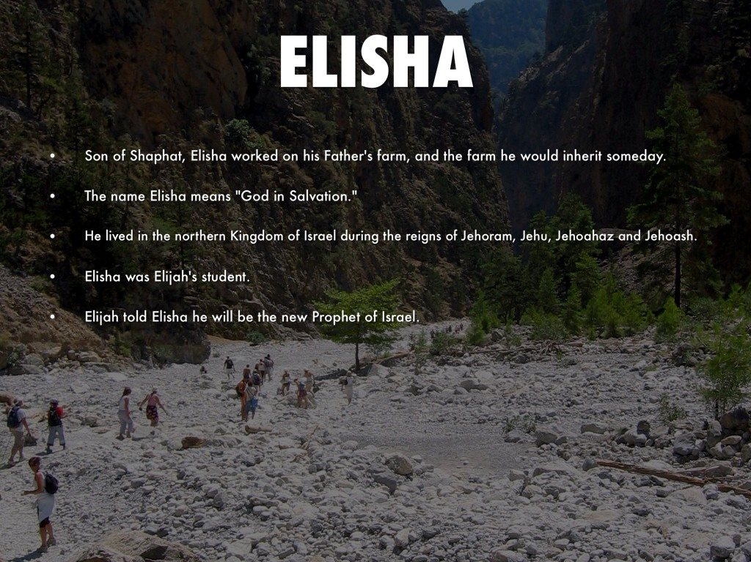

Slide 5
My three points
Checking out the context
Reflecting on the story
Learning the lessons

Slide 6
Checking out the Context

Slide 7
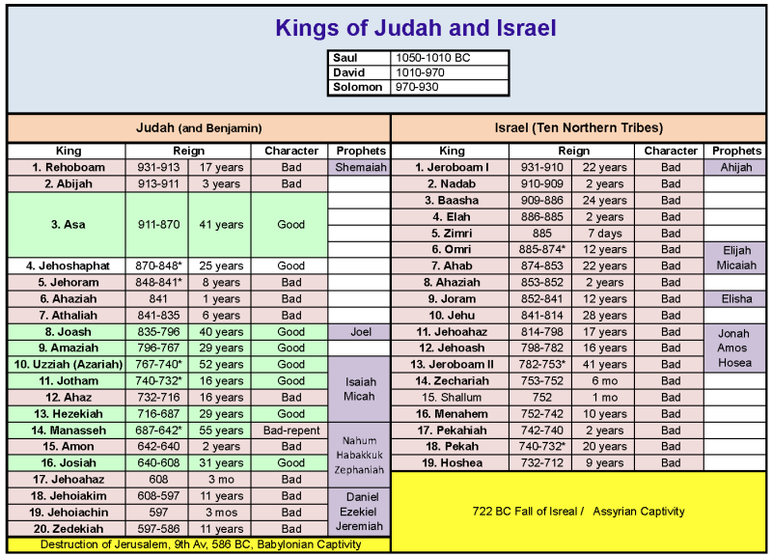

Slide 8
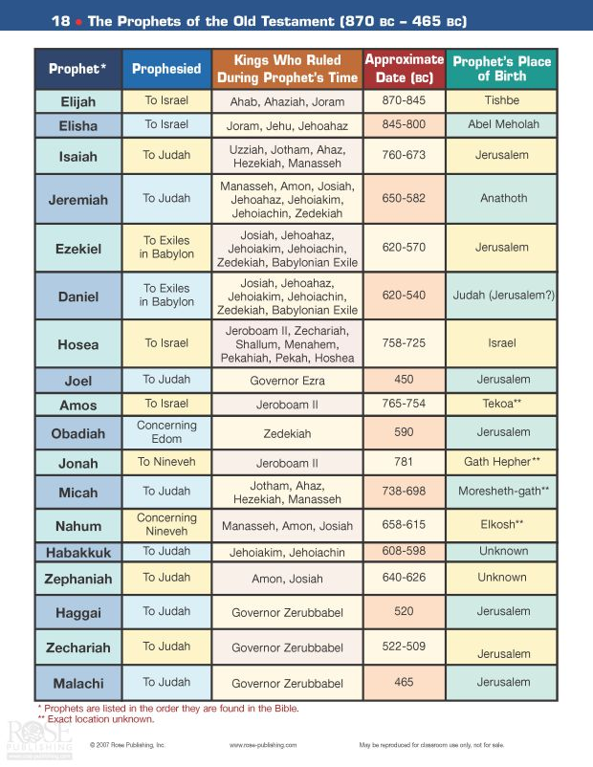

Slide 9
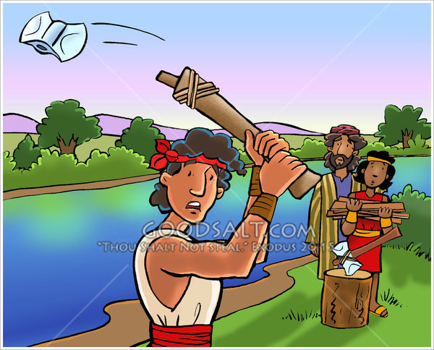
Elisha the miracle worker

Slide 10
Famine in the land
Elisha the responsible one
A challenge met by Elisha

Slide 11
A Chronicles perspective
1 &2 Chronicles more or less covers the period covered by 1&2 Samuel and 1&2 Kings but hardly makes any mention of Elijah and Elisha. Its concern is for the honour and glory of God and what happens when this is neglected and / or upheld.

Slide 12
Reflecting on the story

Slide 13
Keeping a promise
Roger’s induction
Ray’s friend’s response
Someone Roger and Ray approves off
All gleaning something different

Slide 14


Slide 16
A difficult situation
A practical need
An appropriate response
An honest mistake
A brilliant solution
A happy outcome

Slide 17
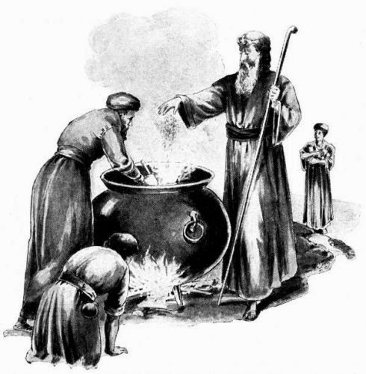

Slide 18
Learning the lessons

Slide 19
The Temptations of Jesus (Matthew 4)
1. The tempter came to him and said, “If you are the Son of God, tell these stones to become bread.” Jesus answered, “It is written: ‘Man shall not live on bread alone, but on every word that comes from the mouth of God.’” (3,4)
2. “If you are the Son of God,” he said, “throw yourself down. For it is written: ... Jesus answered him, “It is also written: ‘Do not put the Lord your God to the test.’” (6,7)
3 “All this I will give you,” he said, “if you will bow down and worship me.” Jesus said to him, “Away from me, Satan! For it is written: ‘Worship the Lord your God, and serve him only.’” (9,10)

Slide 20
Things that can trip us up
Sex
Power
Money
All of which can if wrongly dealt with spoil the good that may be in the pot, together with a whole lot more.
“For we have not an high priest which cannot be touched with the feeling of our infirmities; but was in all points tempted like as we are, yet without sin” (Hebrews 3:4)

Slide 21
On not loving the World
”Do not love the world or anything in the world. If anyone loves the world, love for the Father is not in them. For everything in the world—the lust of the flesh, the lust of the eyes, and the pride of life—comes not from the Father but from the world. The world and its desires pass away, but whoever does the will of God lives forever.” 1John 2 15-17

Slide 22
Catching the little foxes
"Take us the foxes, the little foxes, that spoil the vines: for our vines have tender grapes" Song of Solomon 2:15

Slide 23
Our challenge
“I beseech you therefore, brethren, by the mercies of God, that ye present your bodies a living sacrifice, holy, acceptable unto God, which is your reasonable service. And be not conformed to this world: but be ye transformed by the renewing of your mind, that ye may prove what is that good, and acceptable, and perfect, will of God.” Romans 12 1-2
The great challenge for us is that little bit of death in the pot can ruin the rest that is good and wholesome and if we are to make inroads into extending the Kingdom of God we must deal with death in the pot.

Slide 24
A song and a prayer
“There is a balm in Gilead to make the wounded whole, there is a balm in Gilead to heal the sin-sick soul.”
“Search me, O God, and know my heart: try me, and know my thoughts: And see if there be any wicked way in me, and lead me in the way everlasting.” Psalm 139:23-24

