Slide 1

A Bruised Reed
Isaiah 42 1-7
cf. Matthew 12 9-21
Ref. Philippians 2 5-11

Slide 2
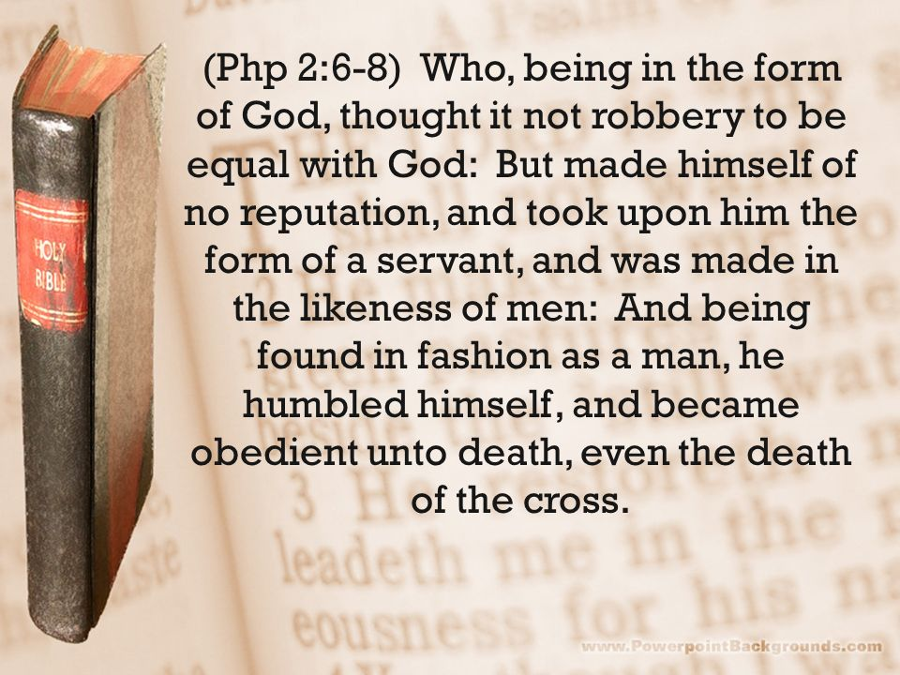

Slide 3
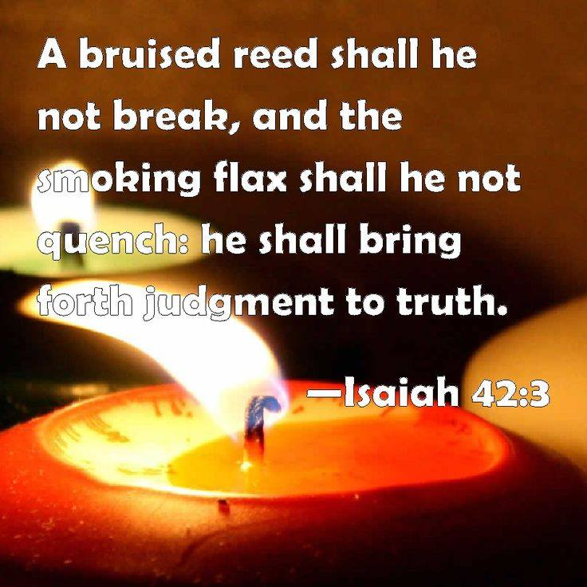

Slide 4
ESV: A bruised reed he will not break, and a faintly burning wick he will not quench; he will faithfully bring forth justice.
KJV: A bruised reed shall he not break, and the smoking flax shall he not quench: he shall bring forth judgment unto truth.
MSG: “Take a good look at my servant. I’m backing him to the hilt. He’s the one I chose, and I couldn’t be more pleased with him. I’ve bathed him with my Spirit, my life. He’ll set everything right among the nations. He won’t call attention to what he does with loud speeches or gaudy parades. He won’t brush aside the bruised and the hurt and he won’t disregard the small and insignificant, but he’ll steadily and firmly set things right. He won’t tire out and quit. He won’t be stopped until he’s finished his work—to set things right on earth. Far-flung ocean islands wait expectantly for his teaching.”
NASB: “A bruised reed He will not break, and a dimly burning wick He will not extinguish; He will faithfully bring forth justice.
NIV: A bruised reed he will not break, and a smoldering wick he will not snuff out. In faithfulness he will bring forth justice;
NKJV: A bruised reed He will not break, and smoking flax He will not quench; He will bring forth justice for truth.

Slide 5
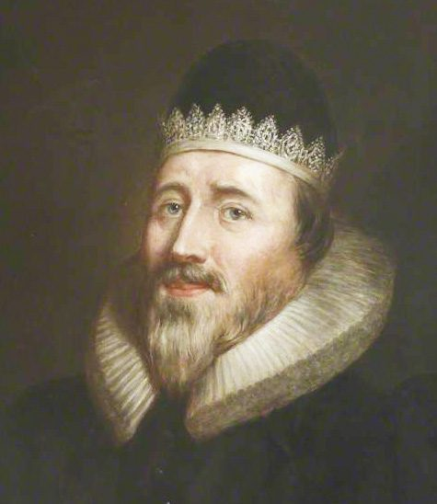
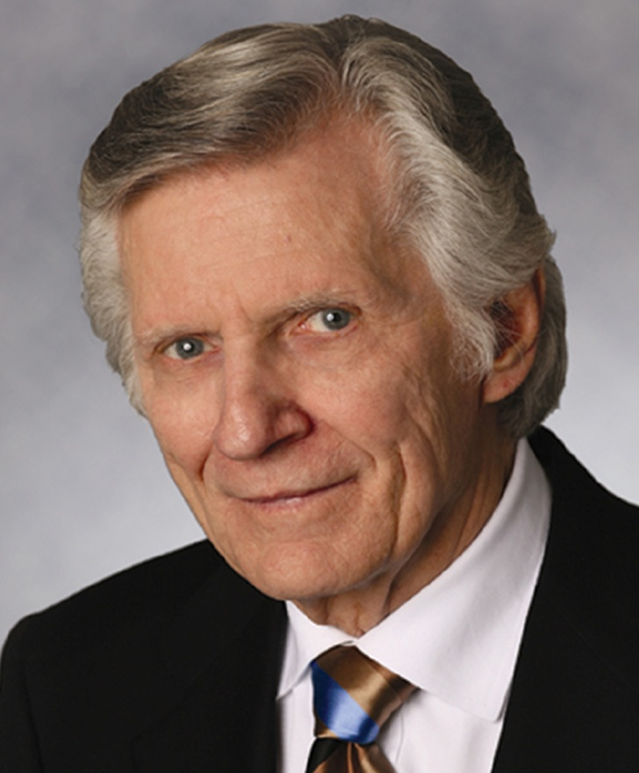
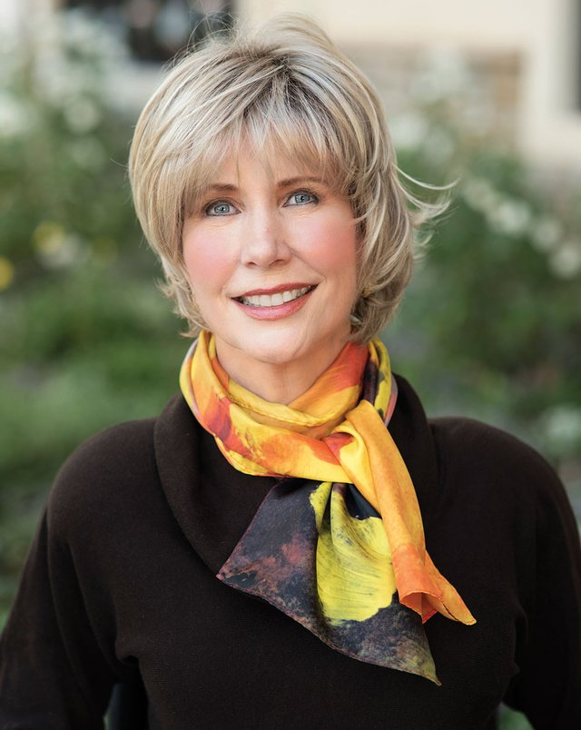
What have these three people got in common?

Slide 6
Servant or slave; doulos and ebed
More than a servant; not quite a slave ...
(servant /slave: doulos NT; ebed OT)
Behold my ebed, whom I uphold; mine elect, in whom my soul delighteth; I have put my spirit upon him: he shall bring forth judgment to the Gentiles – Isaiah 42:1
But made himself of no reputation, and took upon him the form of a doulos, and was made in the likeness of men – Philippians 2:7

Slide 7
Servant – Israel or the Messiah
41 8 But thou, Israel, art my servant, Jacob whom I have chosen, the seed of Abraham my friend
44:1 Yet now hear, O Jacob my servant; and Israel, whom I have chosen
45:1 For Jacob my servant's sake, and Israel mine elect, I have even called thee by thy name
49:3 Thou art my servant, O Israel, in whom I will be glorified
42:1 Behold my servant, whom I uphold; mine elect, in whom my soul delighteth
50:4 The Lord God hath given me the tongue of the learned, that I should know how to speak a word in season to him that is weary
52:13 Behold, my servant shall deal prudently, he shall be exalted and extolled, and be very high

Slide 8
Isaiah 42 1-8 in context
The Lord’s anointed one (v1)
The Servant’s humility (v2)
Bruised reeds and smoking flaxes (v3)
He is resolute in his mission (v4)
The Servant’s calling (vv5-7)
All glory to God (v8)

Slide 9
Matthew 12 9-21 in context
Jesus picks corn on the Sabbath (1-8)
Jesus meets man with withered hand (9-13)
Jesus heals man; Pharisees object (13-16)
Prophesy fulfilled (17-21)
More healings (22-30)

Slide 10
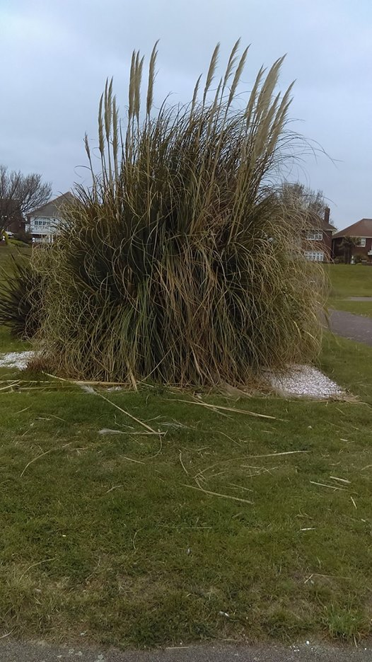

A bruised reed

Slide 11
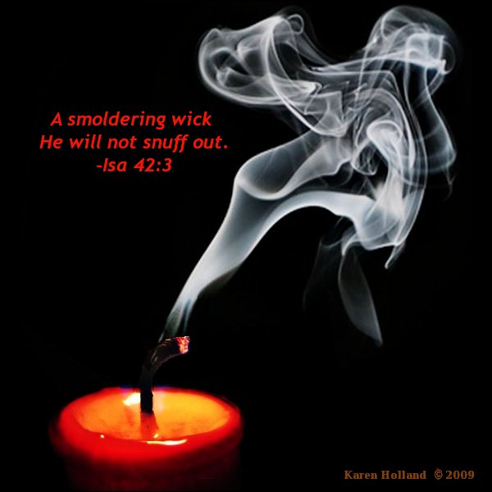

Slide 12
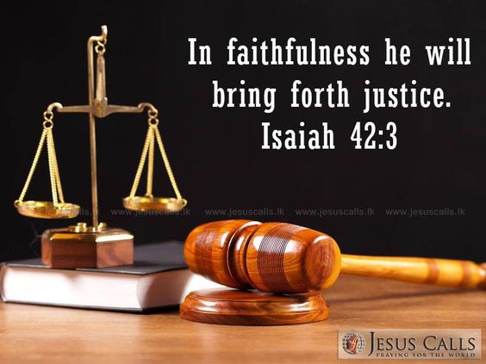

Slide 13
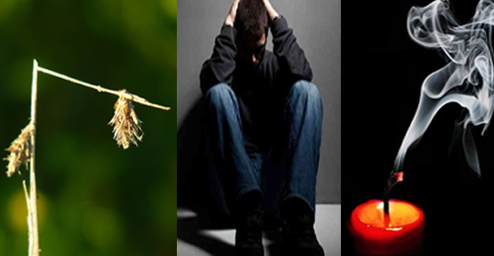
Stories of Hope

Slide 14
Lessons and applications
Bruising and smoking may be a pre-requisite
World full of bruised reeds and smoking flaxes
The church is also full of such
Some bruises may not go away
That tiny glimmer can become a flame
He calls and offers succor, but we must respond
God will remain faithful however weak we are
Don’t ignore bruised reeds and smoking flaxes
God’s just purposes will be carried out
His justice will prevail

Slide 15
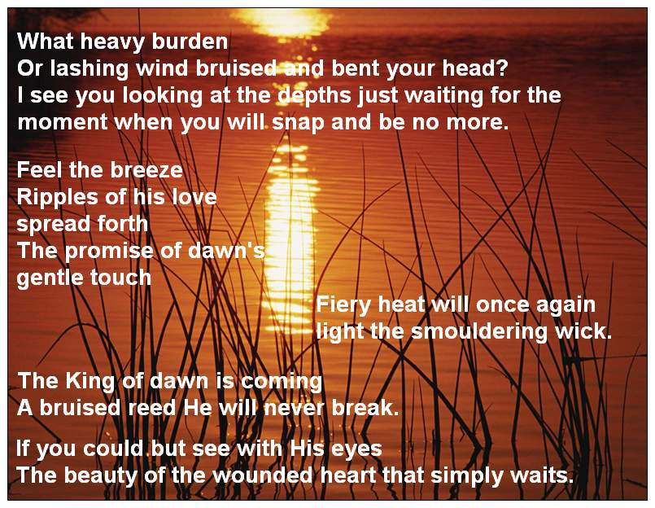

Slide 16
