Slide 1
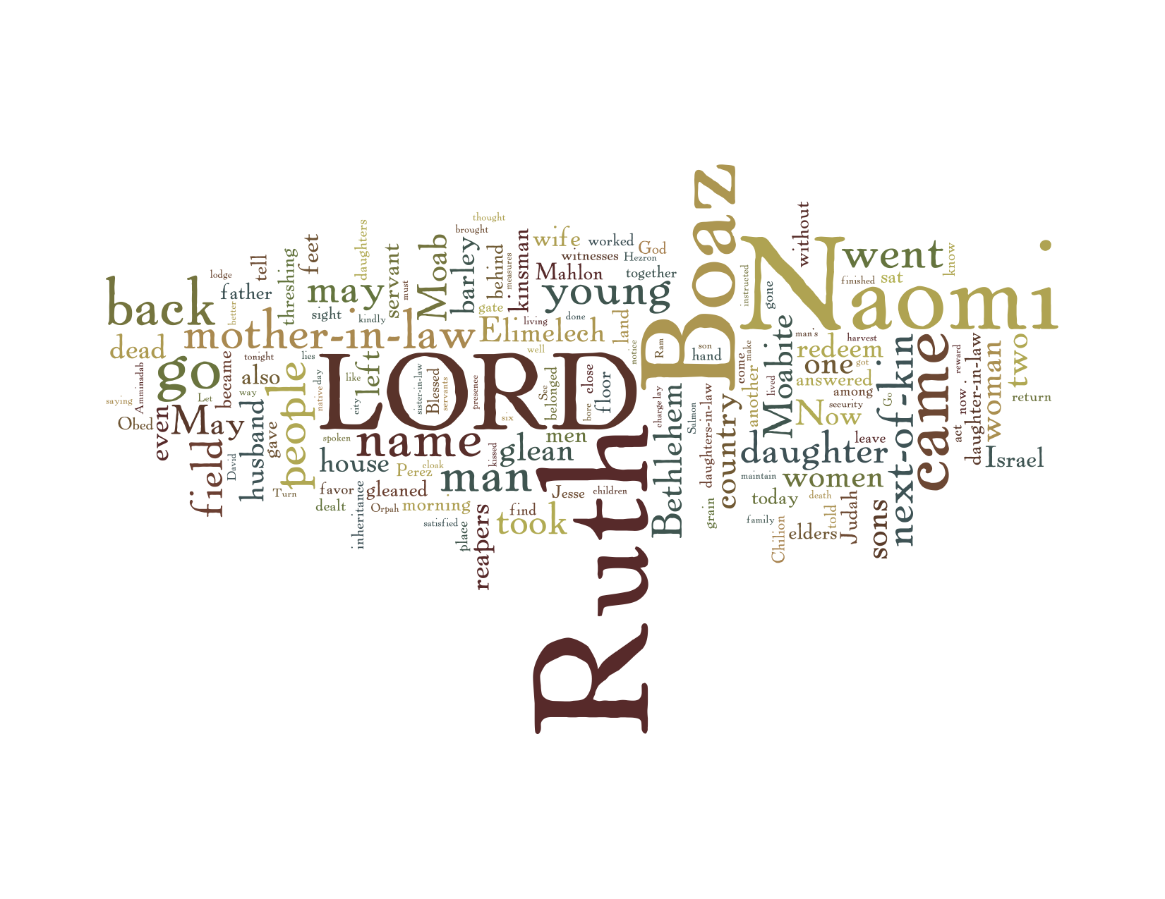
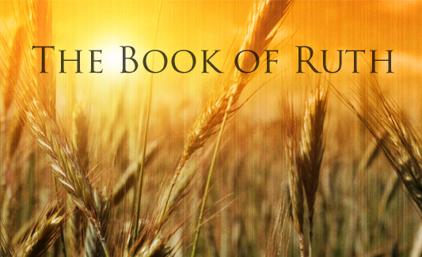

Slide 2
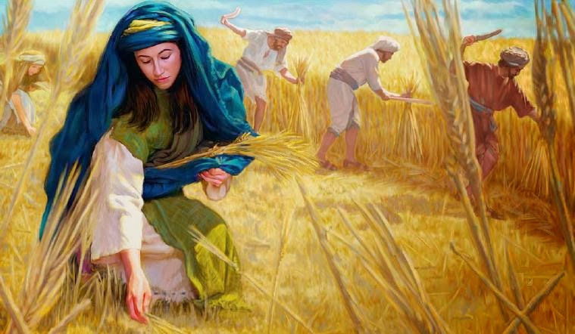
Gleaning
Obtaining information from various sources, often with difficulty.
Collecting leftover crops from farmers' fields after they have been harvested.
The law of gleaning: Leviticus 19:9-10 and 23:22, Deuteronomy 24:19-21

Slide 3
Gleanings in Ruth – part 1
Book of Ruth chapters 1 and 2
(to follow – part 2 – Ruth 3 and 4)
Pentecost and Father’s day??
Selection process – to set aside hang ups, encourage and exalt Christ
A beautiful story – full of suspense and depth but remarkably very little by way of direct teaching or revelation, yet so much to glean
(read in the Message, follow in the NIV, quote from the KJV)

Slide 4
Five main characters
Naomi – the bereaved woman
Orpah – Naomi’s daughter in law
Ruth – Naomi’s daughter in law
Boaz – a relative and landowner
God – ever present presence

Slide 5
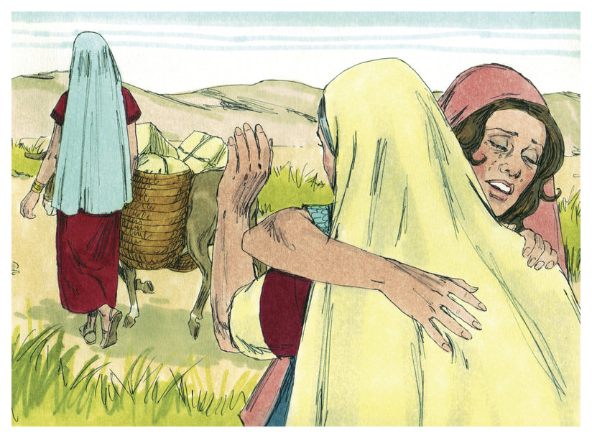
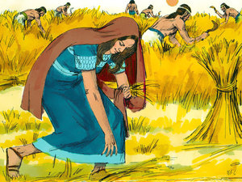
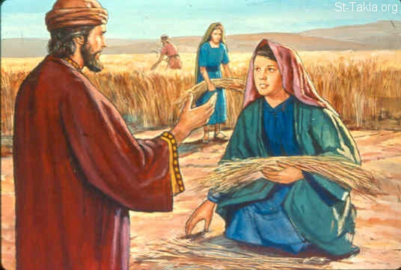
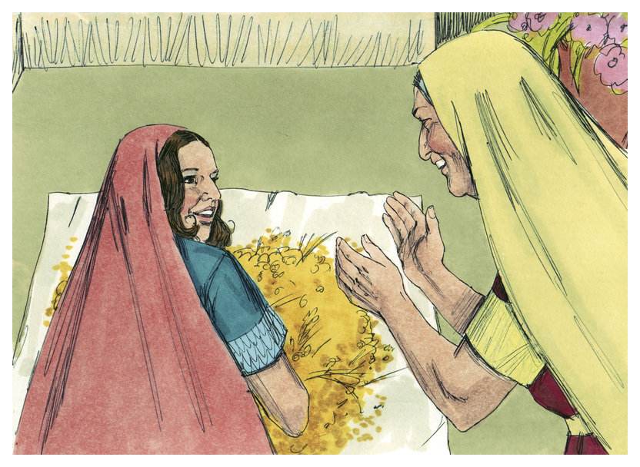
The story up to half way

Slide 6
Naomi
Married to Elimelech; mother of two sons – Mahlon and Kilion; married Orpah and Ruth
Famine appears to be the reason for leaving their home (Bethlehem) to live in Moab
Tragedy strikes – loss of husband and sons
An underlying bitterness was the result
Returning home – desolate, in poverty
Yet she doesn’t lose hope - seeing God work

Slide 7
20 And she said unto them, Call me not Naomi, call me Mara: for the Almighty hath dealt very bitterly with me.
21 I went out full and the Lord hath brought me home again empty: why then call ye me Naomi, seeing the Lord hath testified against me, and the Almighty hath afflicted me?
Ruth 1

Slide 8
Orpah
A dutiful daughter in law
Began to journey back to Naomi’s home
Genuine affection and kindness toward Naomi
Persuaded by Naomi’s arguments
For in the end she turned back when the invitation was given and opportunity arose

Slide 9
11 And Naomi said, Turn again, my daughters: why will ye go with me? are there yet any more sons in my womb, that they may be your husbands?
14 And they lifted up their voice, and wept again: and Orpah kissed her mother in law; but Ruth clave unto her.
Ruth 1

Slide 10
Ruth
A dutiful daughter in law
One that went far beyond the call of duty
An excellent companion
A resourceful woman
Having a humble spirit
Acting with due decorum

Slide 11
14 And they lifted up their voice, and wept again: and Orpah kissed her mother in law; but Ruth clave unto her.
15 And she said, Behold, thy sister in law is gone back unto her people, and unto her gods: return thou after thy sister in law.
16 And Ruth said, Intreat me not to leave thee, or to return from following after thee: for whither thou goest, I will go; and where thou lodgest, I will lodge: thy people shall be my people, and thy God my God:
17 Where thou diest, will I die, and there will I be buried: the Lord do so to me, and more also, if ought but death part thee and me.
Ruth 1

Slide 12
Boaz
A well to do landowner
A good, God fearing man
Attentive to detail
Heart of compassion
Wanting to do the right thing
The nearest kinsman (to Naomi)

Slide 13
3 And she went, and came, and gleaned in the field after the reapers: and her hap was to light on a part of the field belonging unto Boaz, who was of the kindred of Elimelech.
4 And, behold, Boaz came from Bethlehem, and said unto the reapers, The Lord be with you. And they answered him, The Lord bless thee.
Ruth 2

Slide 14
God
Ever present throughout the story even though He doesn’t speak directly
In control come what may – working His purposes out when things don’t make sense
God may seem silent, but he is active
Society functions when God is feared
Gleaning – part of the welfare culture
Looking after the foreigner
The importance of marriage and the family
The law concerning redemption

Slide 15
3 And she went, and came, and gleaned in the field after the reapers: and her hap was to light on a part of the field belonging unto Boaz, who was of the kindred of Elimelech.
4 And, behold, Boaz came from Bethlehem, and said unto the reapers, The Lord be with you. And they answered him, The Lord bless thee.
Ruth 2

Slide 16
In conclusion
The unraveling of the principle characters – Naomi, Orpah, Ruth and Boaz
A woeful beginning but things get better
Things that don’t just happen; God is working
Marvel at the human spirit
God can turn tragedy into triumph
We gain more than what we lose if for God
Things looking up but the best is yet to come

